Slide 1
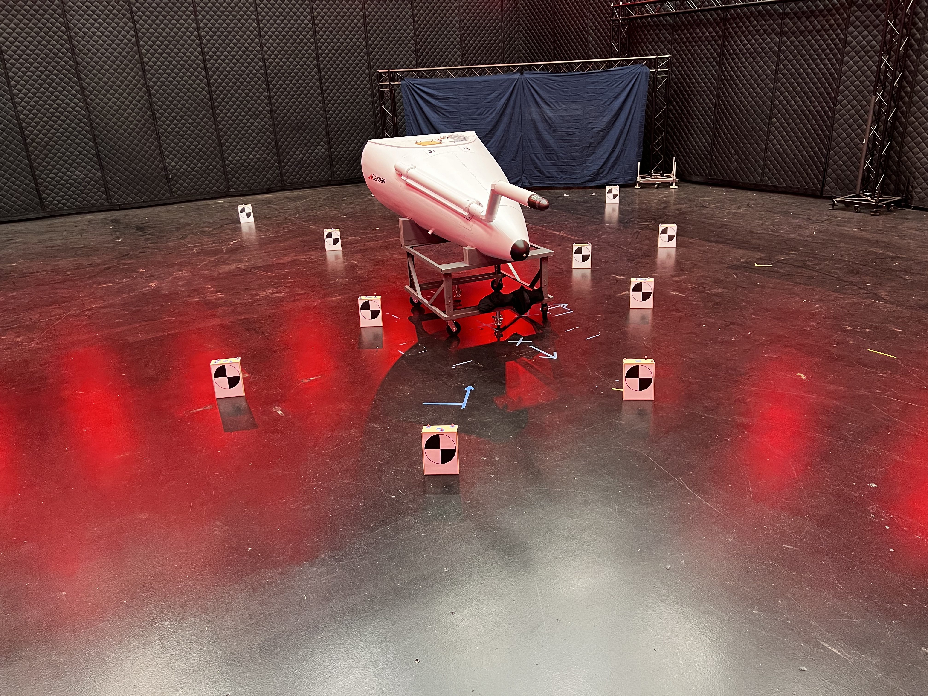

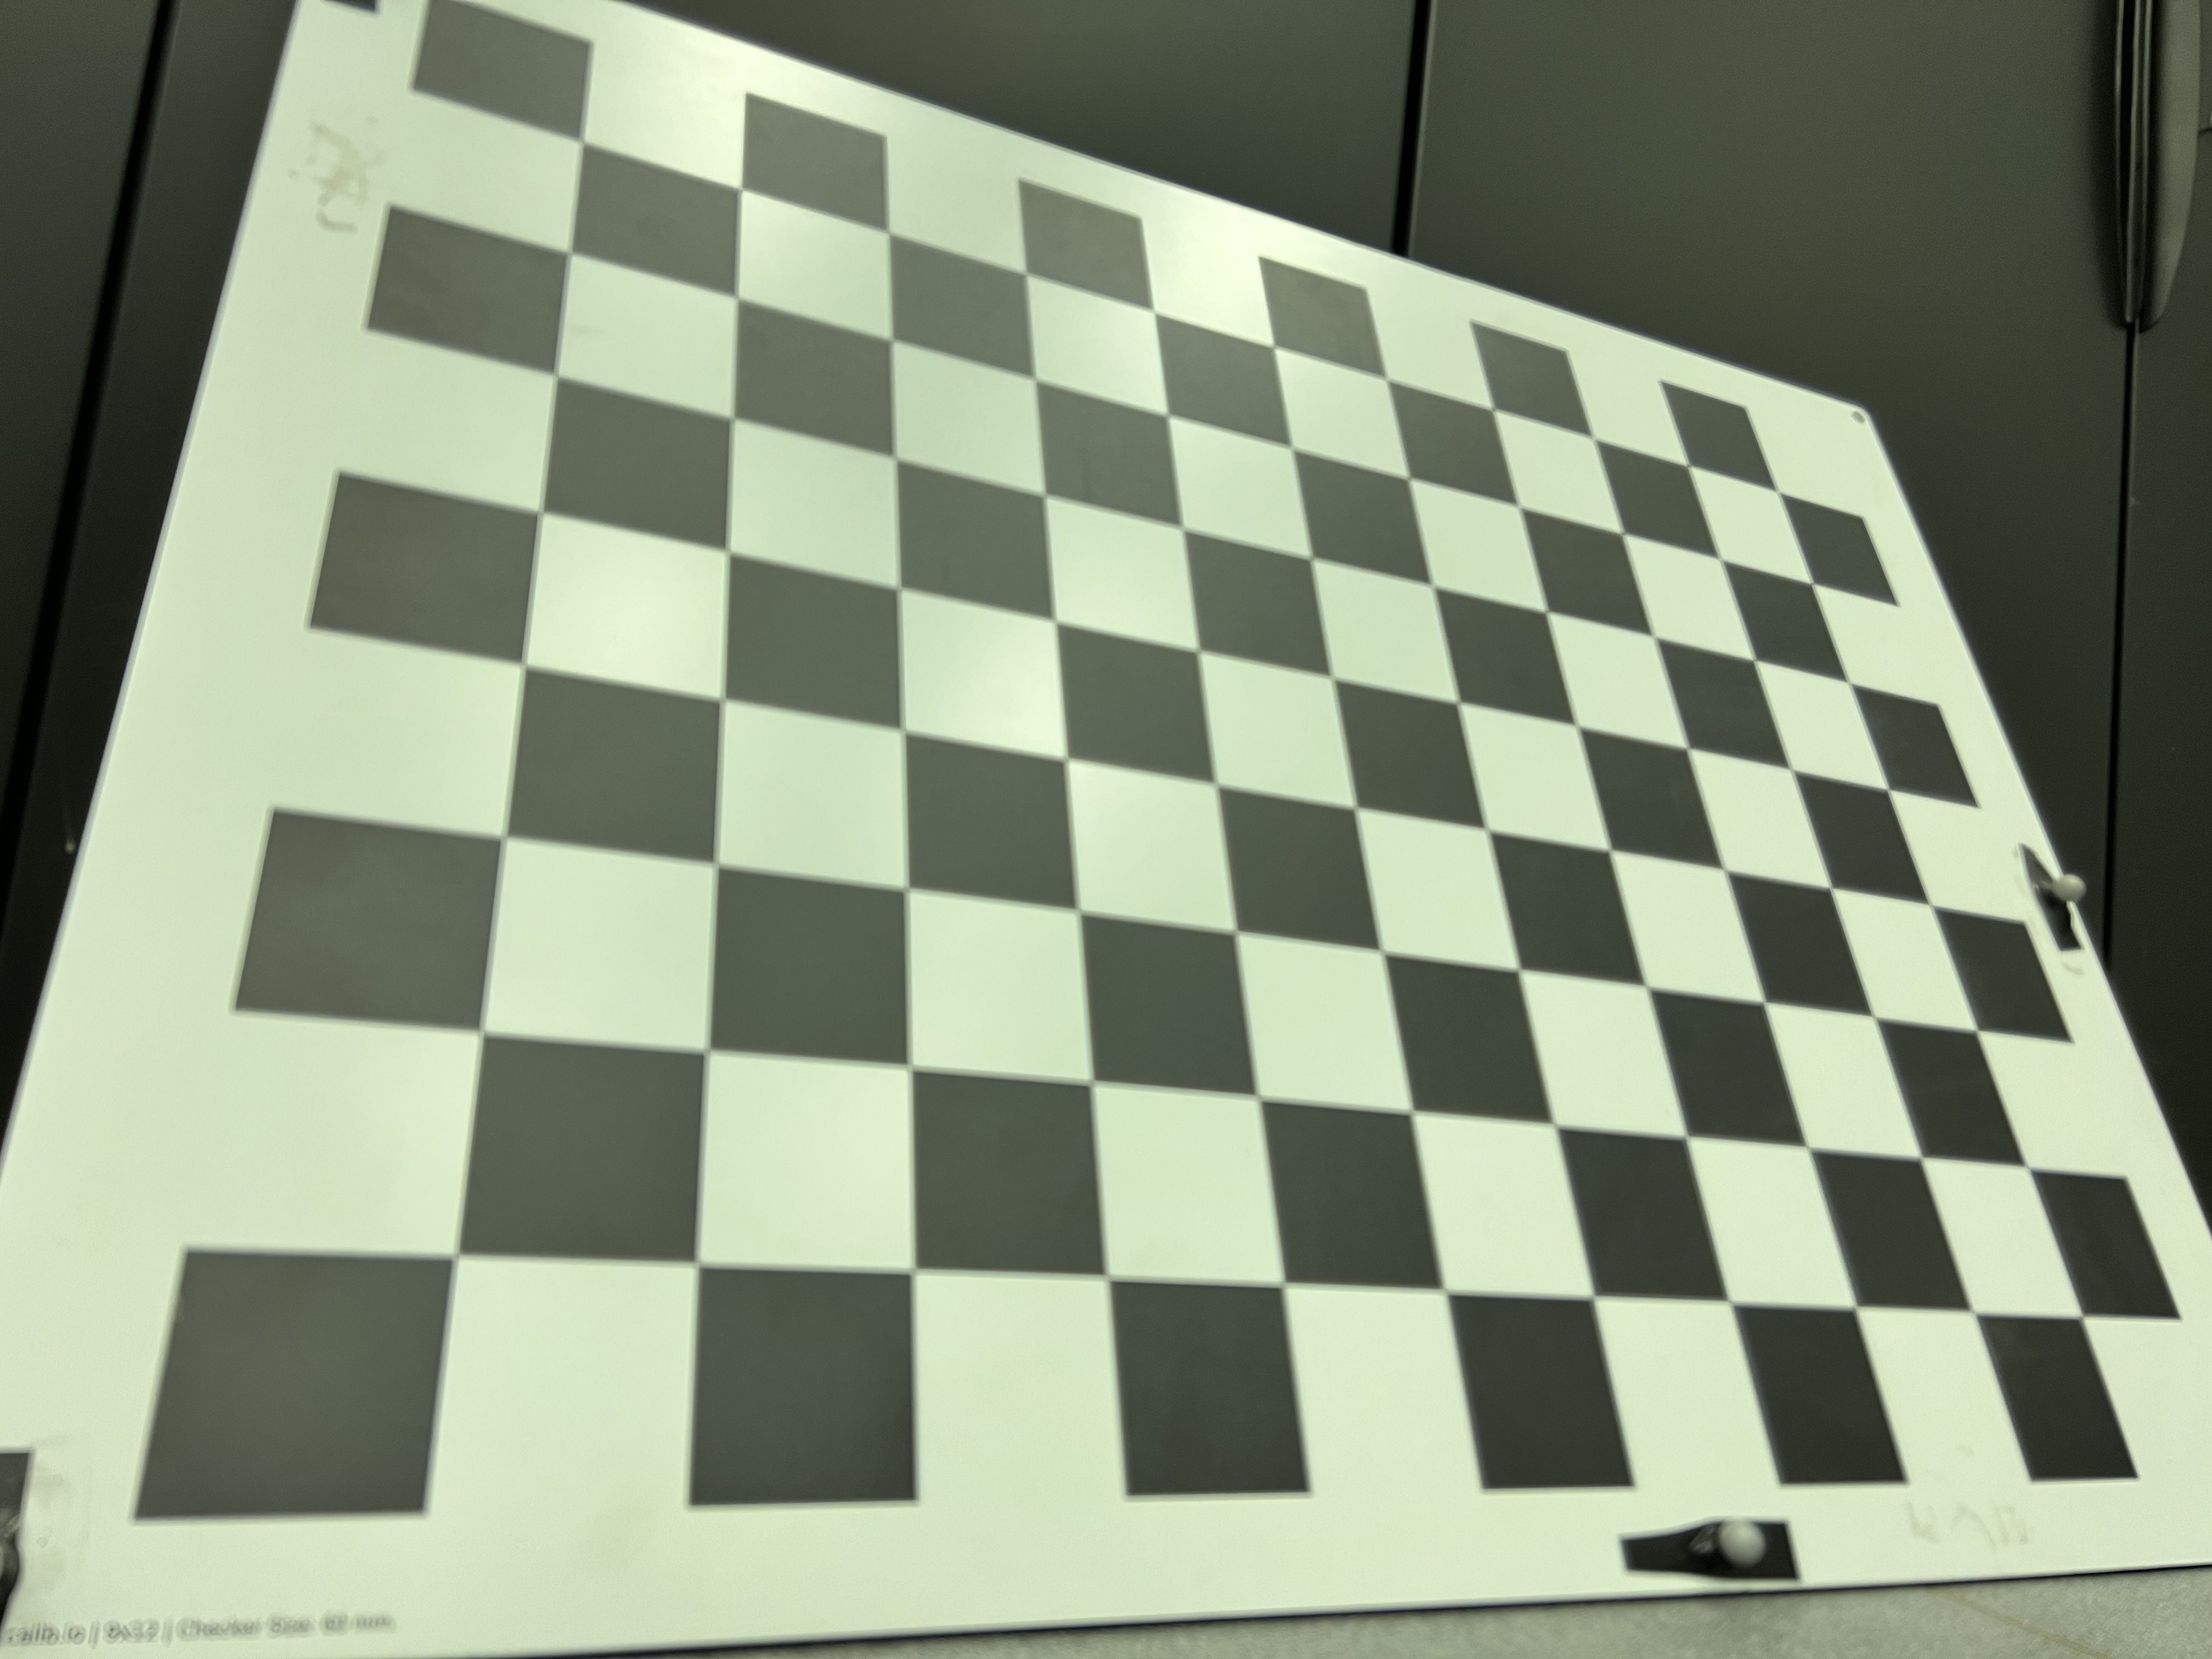
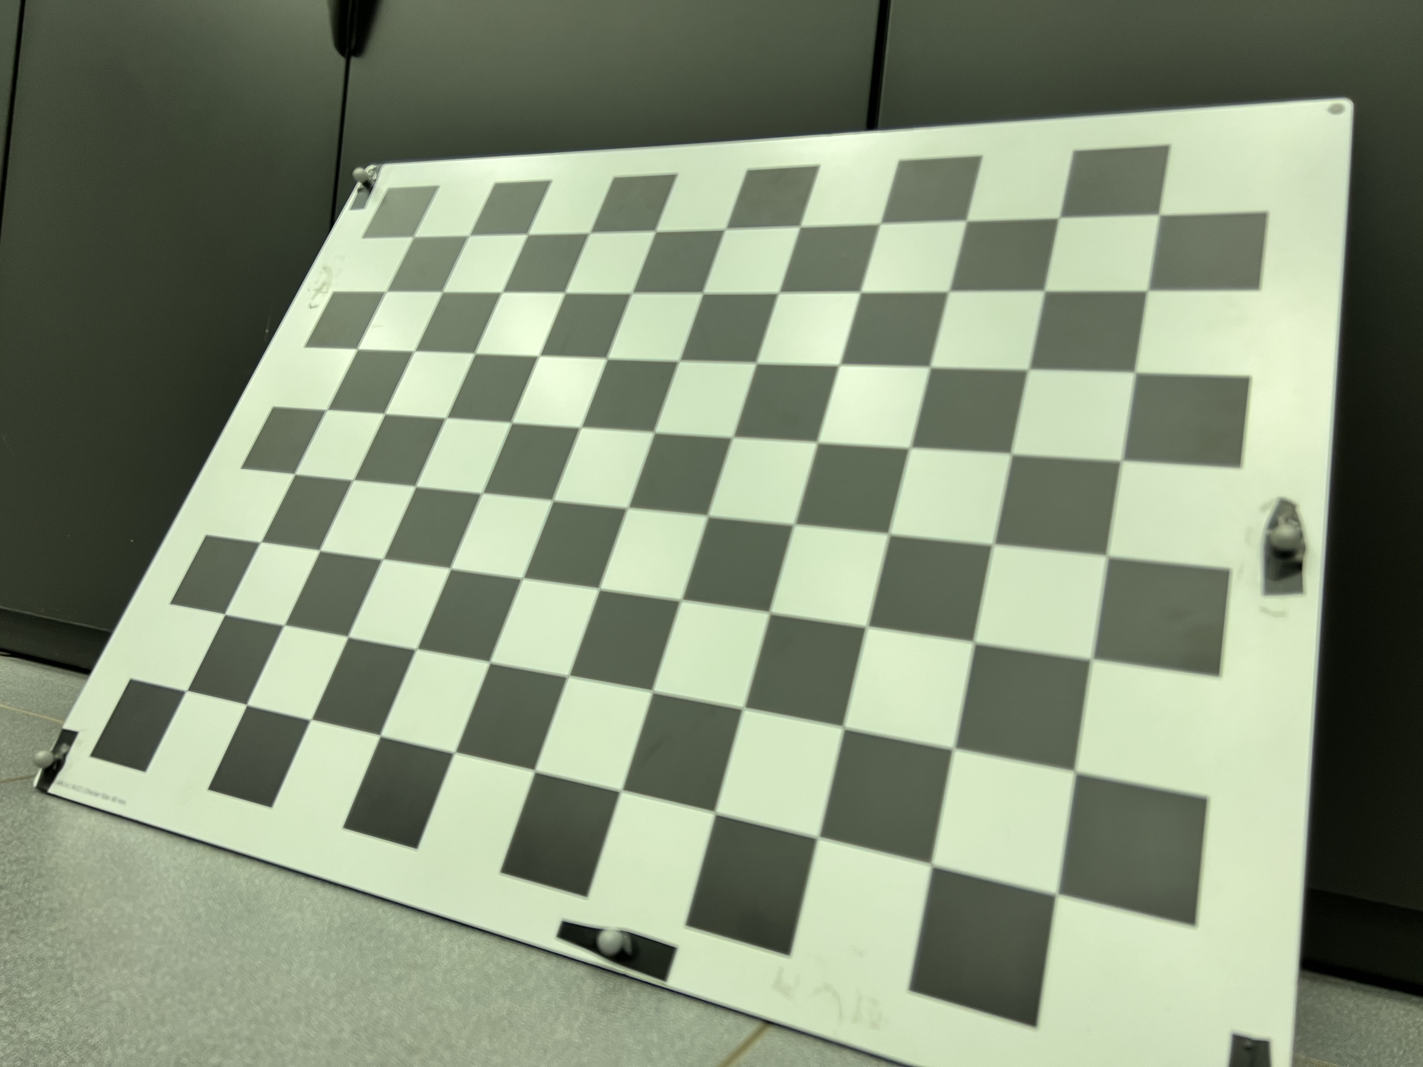
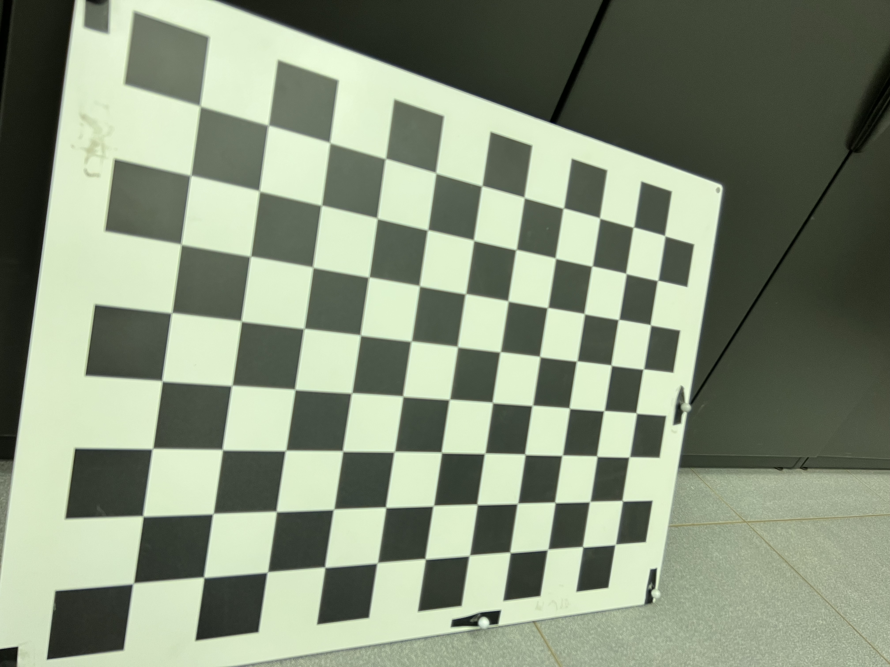
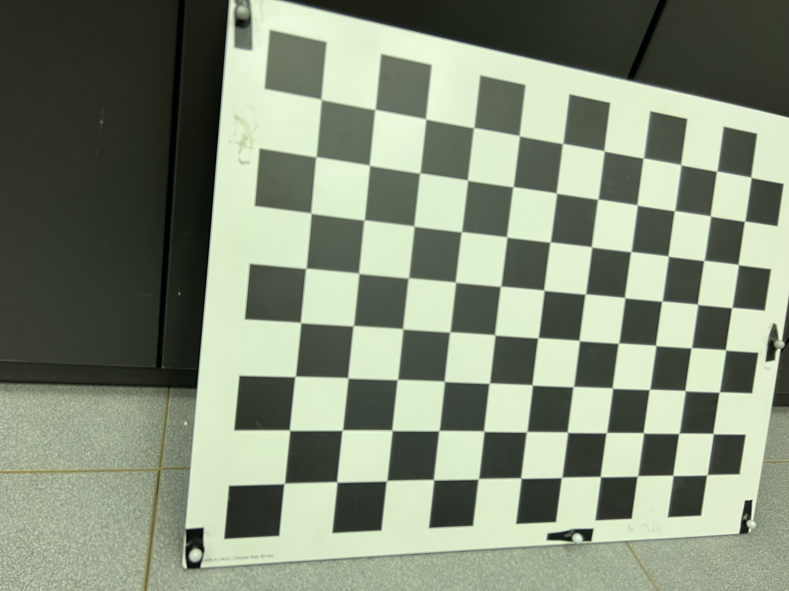
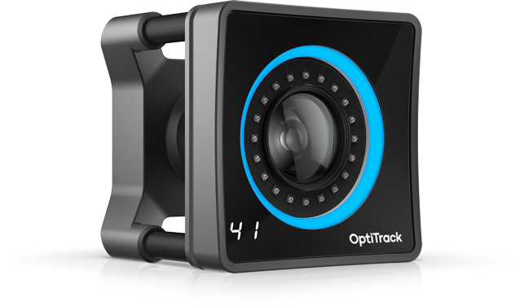

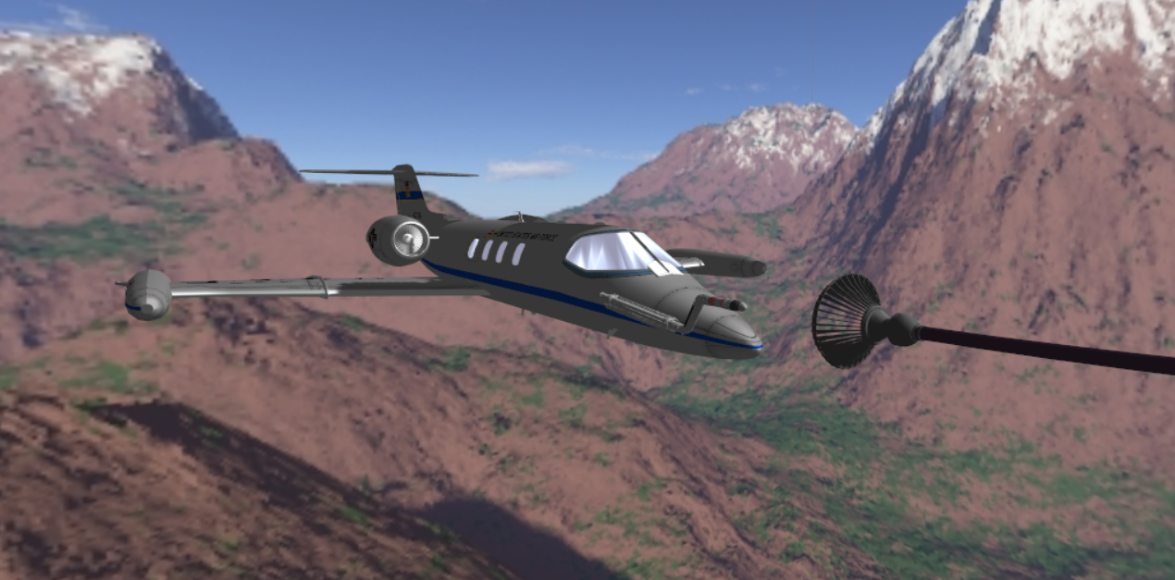
Camera
2D points
Solve
PnP
image capture
3D points
rvec
tvec
Camera Instrinsics
(from chessboard calibration)
Fiducial targets
3D points
marker
balls
Project
Points
marker
balls
3D points
motion capture
Learjet nose cone
MCS
2D points
2D points
2D points
Digital Twin
Reprojections back into
original image

